Slide 1
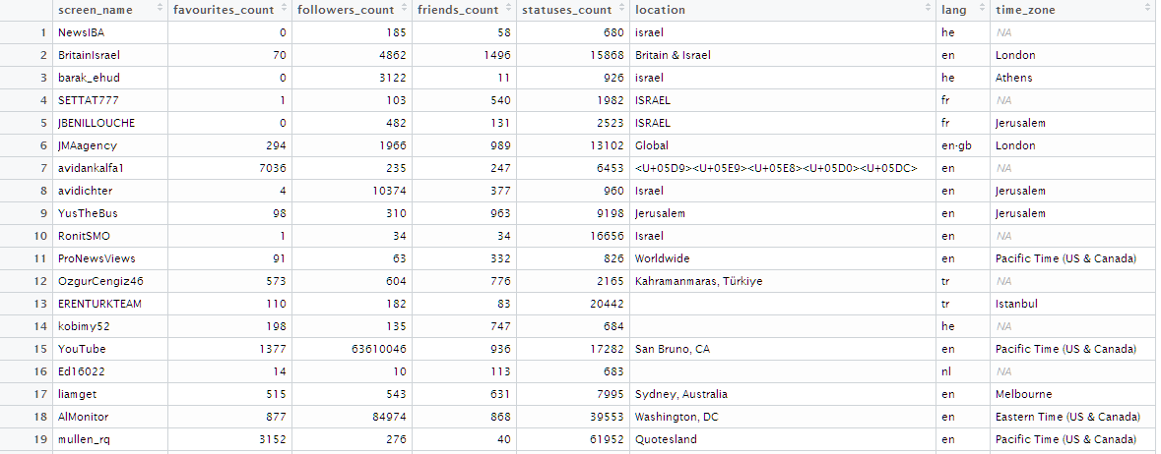
Datasets
Edges and nodes in 2 datasets sizes: Small and Big.
Nodes composes of information of the twitter user. Not all information is needed for the clustering task. So I keep only the relevant. Example:
Those attributes can help in the clustering process and also in the display of the network. For example: High followers nodes might be larger in the graph.

Slide 2
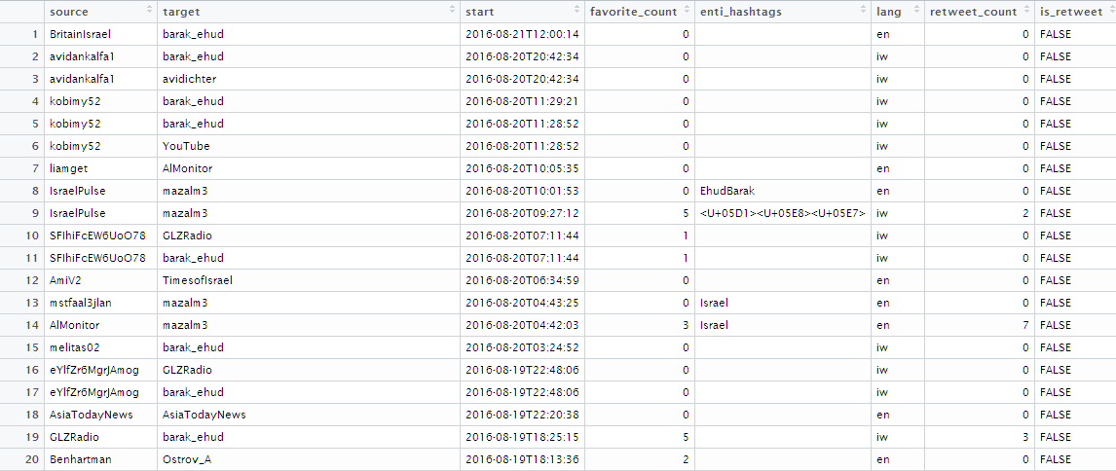
Datasets
Edges composes of information between the 2 edges of the tweet.
Like in the nodes case, not all information is relevant. I remove the fictive tweets, self tweets and also add a marker of whether it is a re-tweet.
This table can now be merged with the nodes table into one table with all information.

Slide 3
Application
We are aiming on finding the communities based on the tweeter data.
Louvain is a fast greedy community detection clustering algorithm. It is a hierarchical bottom-up approach. It optimizes the modularity in a greedy manner. Initially, every vertex belongs to a separate community, and communities are merged iteratively such that each merge is locally optimal (i.e. yields the largest increase in the current value of modularity). The algorithm stops when it is not possible to increase the modularity any more, so it gives you a grouping as well as a dendogram. The method is fast and it is the method that is usually tried as a first approximation because it has no parameters to tune. However, it is downfall is different results given slight changes in the input sets.
This algorithm can enter initial clustering (As initial condition), weights as well additional information to help the clustering (language, location etc’..)

Slide 4
Performance
Not including reading/writing the data/results from/to DB
Simulation performed on Win10, 32GB DDR4 RAM, Processor Intel(R) Core(TM) i7-5820K CPU @ 3.30GHz, 6 Cores
# | Data | Description | Weights | Tweets | Edges | Nodes | Time | Memory | Modularity
1 | Small | Source-Targets only | No | 180 | 111 | 180 | 0.0053 s | 10KB | 0.551
2 | Small | Source-Targets only | Yes | 180 | 111 | 140 | 0.0052 s | 10KB | 0.551
3 | Big | Source-Targets only | No | 61748 | 36733 | 23601 | 0.15 s | 2.6MB | 0.6
Many other application can be then made
Checking only re-tweets
Add weights in form of other information (#followers, #friends, #followers etc’..)
Filter by hashtags , location, languages etc’…
Focus only on highly connected nodes only (speed + performace)
Make a simulation of a “tweet” and how it moves in the network

Slide 5
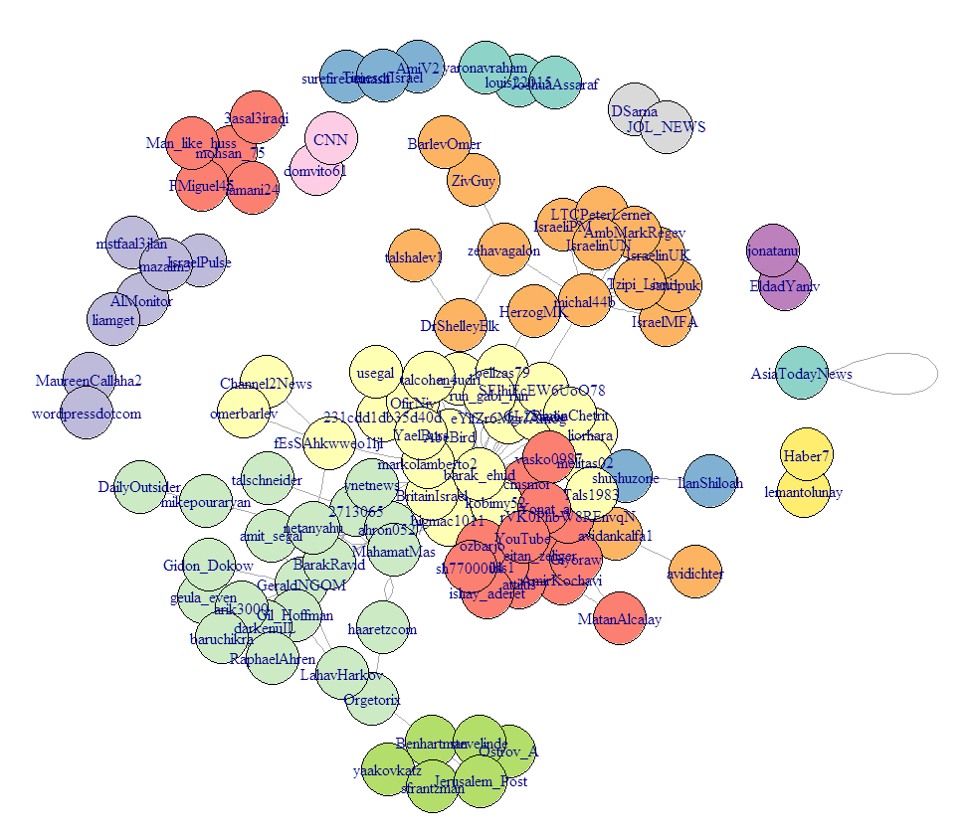
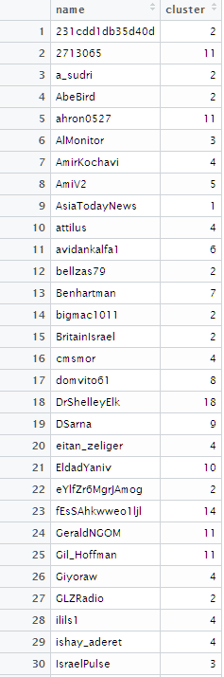
Small Data Set results
Visualization + Output CSV

Slide 6
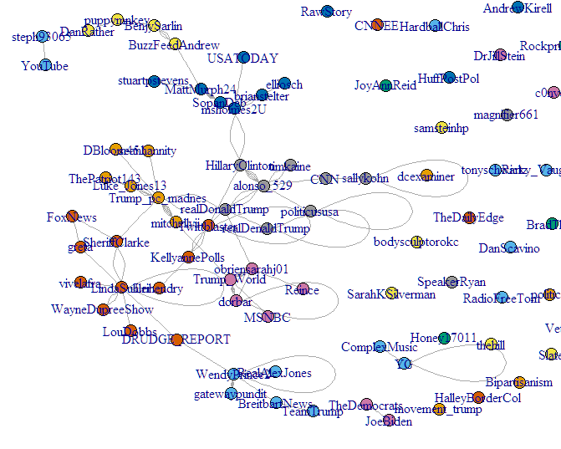
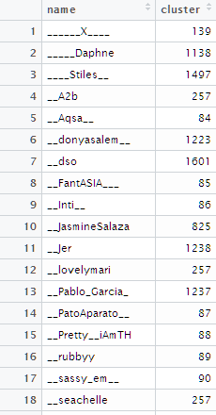
Big Data Set results
Visualization + Output CSV
Those are only part of the top
connected nodes.

Slide 7
Useful References
https://www.r-bloggers.com/network-visualization-in-r-with-the-igraph-package/
http://blog.kaggle.com/2016/06/03/dataset-spotlight-how-isis-uses-twitter/
https://www.kaggle.com/msjgriffiths/d/kzaman/how-isis-uses-twitter/social-cluster-analysis-in-r/comments
https://www.kaggle.com/ggospodinov/d/kzaman/how-isis-uses-twitter/tweet-analysis2/notebook
https://en.wikipedia.org/wiki/Louvain_Modularity
http://igraph.org/r/doc/
http://thinktostart.com/visualize-retweets-with-r/
http://kateto.net/network-visualization
https://rdatamining.wordpress.com/2012/05/17/an-example-of-social-network-analysis-with-r-using-package-igraph/
https://perso.uclouvain.be/vincent.blondel/research/louvain.html
http://www.ludowaltman.nl/slm/
https://www.quora.com/Is-there-a-simple-explanation-of-the-Louvain-Method-of-community-detection

